Slide 1
Prismatic Heretic
““Three swords, one heretic, no mercy”” By Sigma Squad: Dann Kaoussarani Mohamad Ghanmeh Dominique Cartier Jennifer Osorio Adrien Kamran Le Cherng Lee

Slide 2
Premise
Basic setting
What makes the game interesting
Selling point to convince the publisher

Slide 3
Story

Slide 4
Mechanics
1
2
3
4

Slide 5
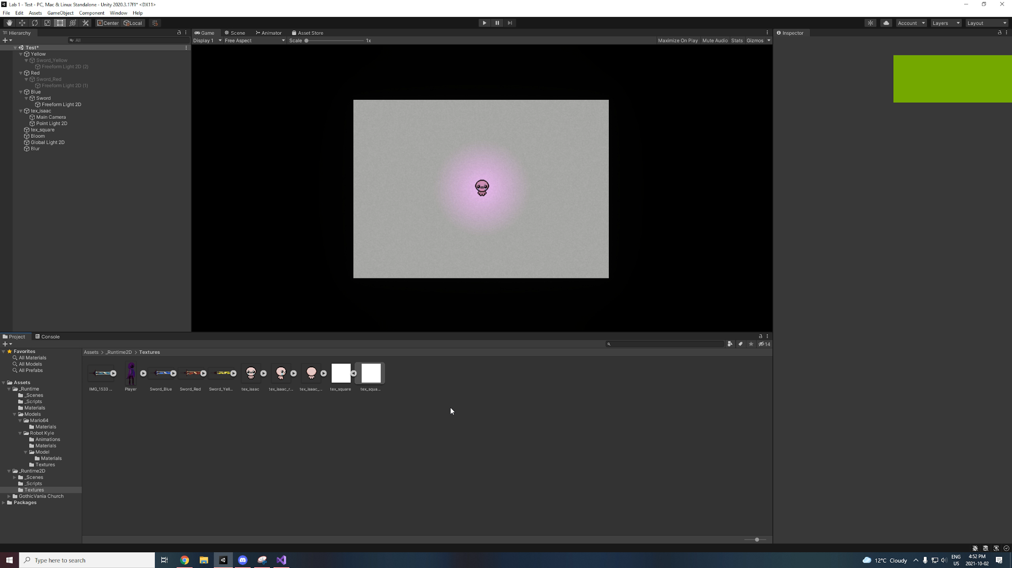
Mechanics
tell

Slide 6
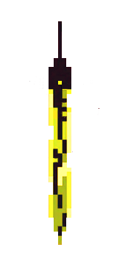
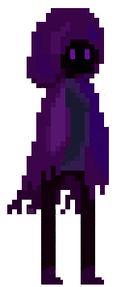
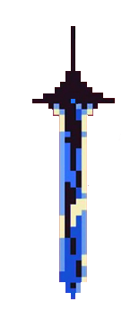
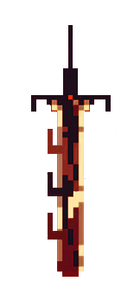
Art

Slide 7
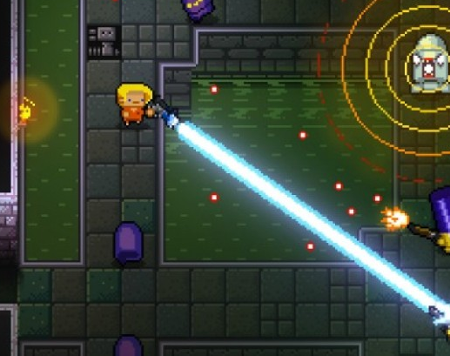
Enter the Gungeon
Multiplatform
Dodge Roll
2016

Slide 8
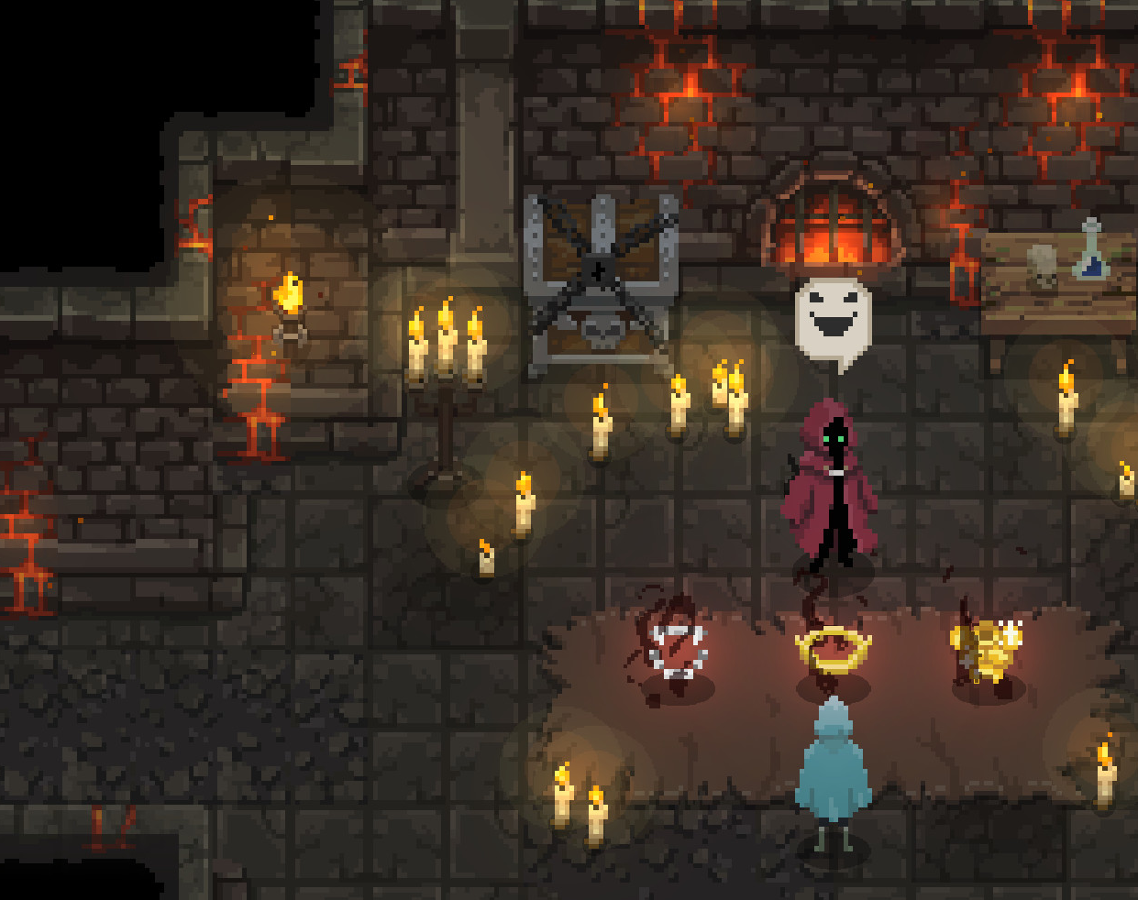
Wizard of Legend
Multiplatform
Continent 99
2018

Slide 9
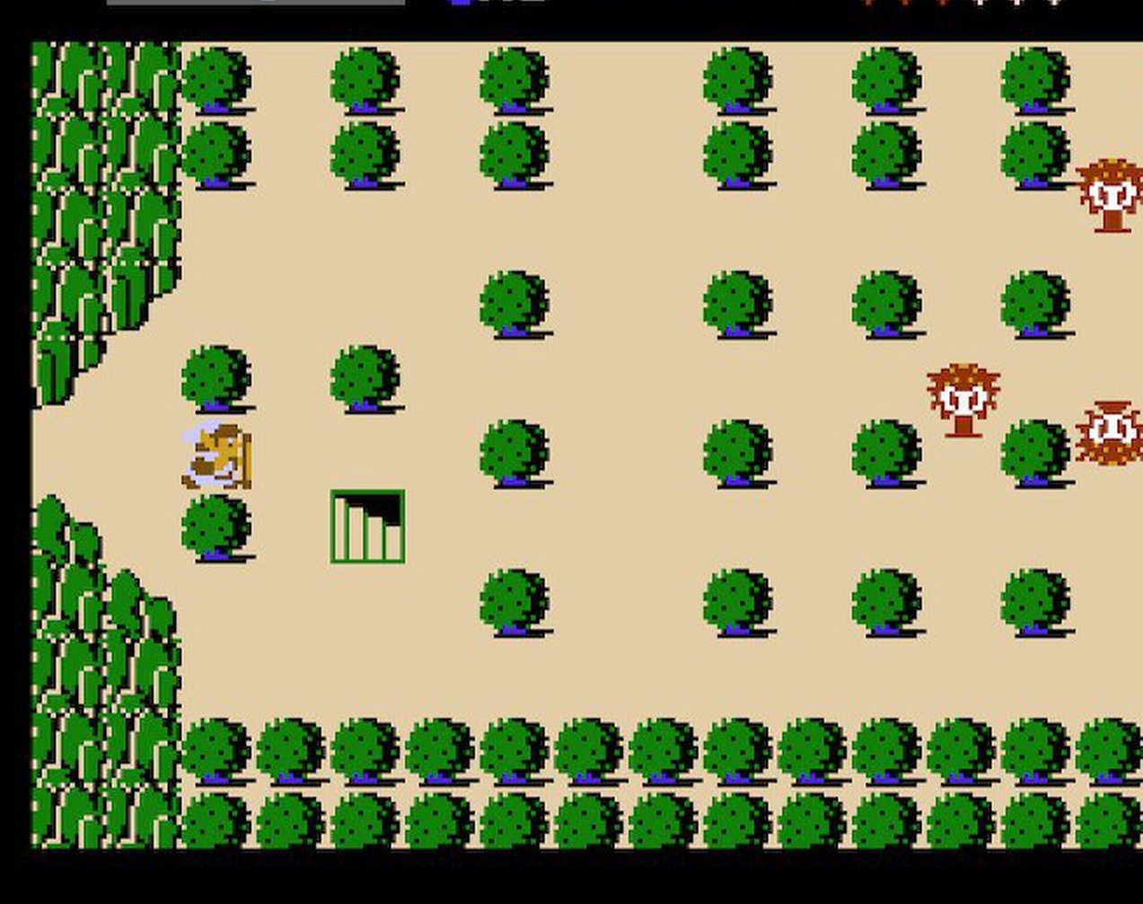
Legend of Zelda
Nintendo
1986

Slide 10
Roles
Character control and weapon mechanics:
Dann
Adrien
Dominique
Enemy AI and Level Design:
Lee
Jennifer
User Interface:
Mohamad

Slide 11
Roles
Asset Creation:
Mohamad
Adrien
Dominique
Music:
Lee

Slide 12
Thank you!

